Slide 1




Powering Your Business with Data-Driven Insights
Unlock Efficiency
Save Cost
Drive Growth!
Created By:
Team Data Analytics & ML
www.scalenowtech.com

Slide 2
Agenda
Exploring Data-Driven Insights
Review of Selected Tools
Excel's Role in BA
Introducing ScaleNow's Solution
Overview of BA Tools
Solution, Expertise & Pricing
www.scalenowtech.com

Slide 3







Data-Driven Insights: Overview
Importance of Data
Improved Efficiency
Cost Savings
Enhanced Growth
Strategic Advantage
Data drives informed decisions, reducing guesswork in strategy.
Streamlined processes lead to quicker outcomes and resource optimisation.
Data insights help identify cost-cutting opportunities across operations.
Leveraging data fosters innovation and guides strategic growth initiatives.
Companies use data-driven strategies to outperform competitors effectively.
www.scalenowtech.com

Slide 4

















Excel: The Essential Tool for Business Analysis
01
02
03
04
05
Excel as a Data Analysis Tool
Financial Reporting Importance
Handling Large Datasets
Collaboration Challenges
Limited Advanced Analytics
Potent for data analysis
Efficient manipulation
Visualize data
Struggles with large data
Performance issues
Analysis hindrance
Cumbersome collaboration
Multi-user difficulties
Simultaneous work challenges
Vital for financial reporting
Informed decisions
Accurate data presentation
Lacks advanced capabilities
Unsuitable for complex tasks
www.scalenowtech.com

Slide 5







Features of Mostly Used BI Tools
Power BI
Tableau
Metabase
Notion
Data integration
Advanced visualizations
Open-source
Note-taking
AI-driven insights
Data blending
SQL-based queries
Task management
Real-time dashboards
Real-time data processing
Dashboard creation
Integration with popular apps
Templates
Collaboration features
Drag-and-drop interface
Cost-effective
Security (row-level security, encryption)
Flexible Deployment
Collaboration via Tableau Server
Flexible Deployment
Self-hosted option
Data Protection
Lightweight analytics
Flexible Deployment
www.scalenowtech.com

Slide 6
What is Power BI?
Power BI Desktop
Power BI Service
Power BI Mobile
Power BI is a collection of software services, apps, and connectors that work together to turn your unrelated sources of data into coherent, visually immersive, and interactive insights. Your data might be an Excel spreadsheet, or a collection of cloud-based and on-premises hybrid data warehouses. Power BI lets you easily connect to your data sources, visualize and discover what's important, and share that with anyone or everyone you want.
Basic Parts:
A Windows desktop application called Power BI Desktop
An online software as a service (SaaS) service called the Power BI service
Power BI Mobile apps for Windows, iOS, and Android devices

Slide 7
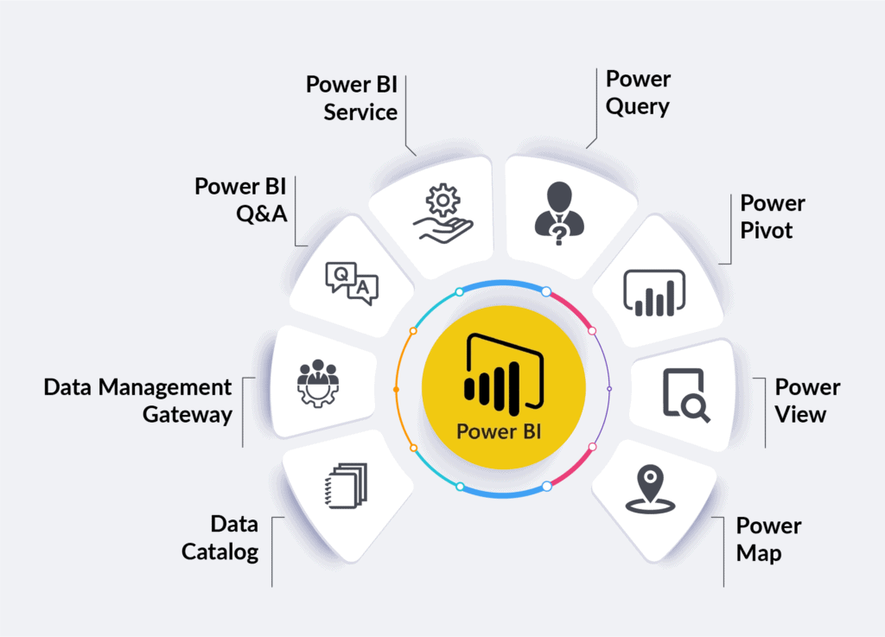
Why choose Power BI?
All-in-One Solution- Power BI integrates tools for querying, modeling, and visualizing data in one platform.
Real-time Insights- Build interactive dashboards with real-time data updates for faster decision-making.
Cross-Platform Access- Available on desktop, web, and mobile, ensuring you can access reports anywhere.
Microsoft Integration- Works seamlessly with Excel, Azure, and other Microsoft tools for better workflow.
Advanced Features- Utilize Power Query, Power Pivot, and more for deeper data analysis.

Slide 8


Before vs After
Power BI transforms how data is presented.
The left dashboard is basic—functional but limited in customization and insights.
The right dashboard, enhanced with Power BI, is interactive, visually engaging, and highlights key trends, making decision-making faster and easier.
It turns simple data actionable insights, helping businesses focus on what matters most.

Slide 9
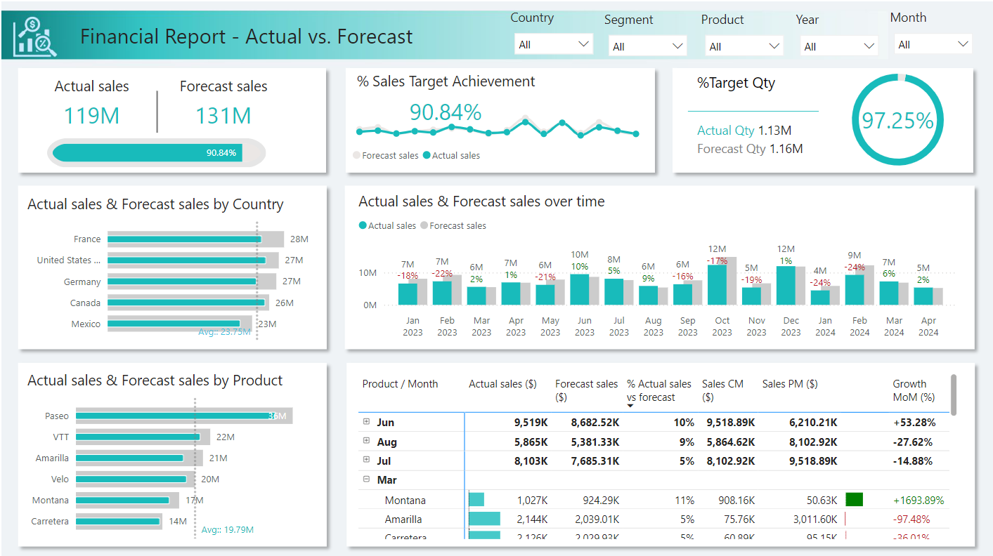
Power BI Sales Dashboard
Sales Performance in Industry
Sales is the lifeblood of any business, with key metrics like actual vs. forecast sales, sales target achievement, and growth rates being essential to monitor. Industries like retail, e-commerce, and consumer goods rely on real-time insights to adjust strategies and hit their sales goals. Without tracking these KPIs, businesses may miss growth opportunities or fail to meet targets.
Power BI provides real-time insights, allowing businesses to track and optimize sales performance.
www.scalenowtech.com

Slide 10
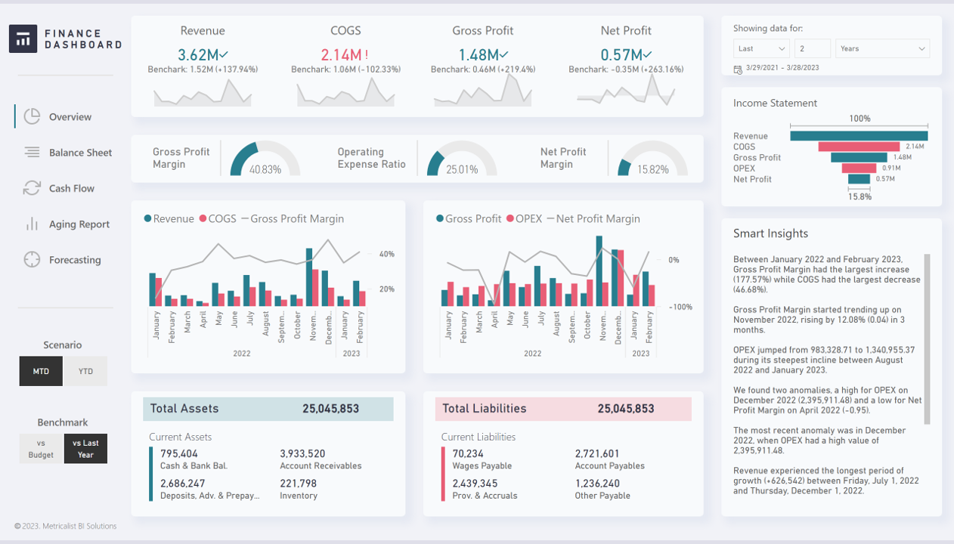
Power BI Finance Dashboard
Financial Health Monitoring
Tracking financial KPIs is critical for ensuring business stability and growth. Metrics like Revenue, Gross Profit Margin, and Net Profit provide insight into a company’s profitability, while Total Assets and Liabilities help businesses manage their balance sheets effectively. In industries like banking, insurance, and corporate finance, real-time financial insights are crucial for making data-driven decisions and improving financial planning.
Power BI delivers real-time financial insights for quick, informed decision-making.
www.scalenowtech.com

Slide 11
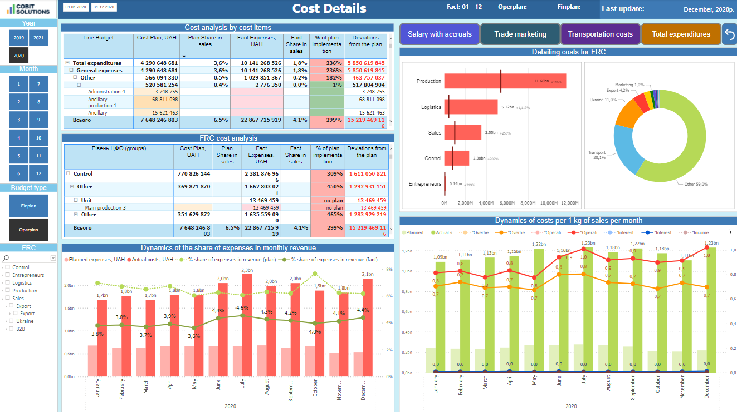
Power BI Manufacturing Dashboard
Manufacturing Cost Management in Industry
Manufacturing requires close tracking of production costs, logistics, and operational efficiency to stay profitable. KPIs like planned vs. actual costs, cost per unit, and budget deviations help optimize processes and reduce waste. Industries such as automotive and consumer goods rely on detailed cost analysis to stay competitive.
Power BI provides real-time cost insights, helping manufacturers optimize production and control expenses effectively.
www.scalenowtech.com

Slide 12
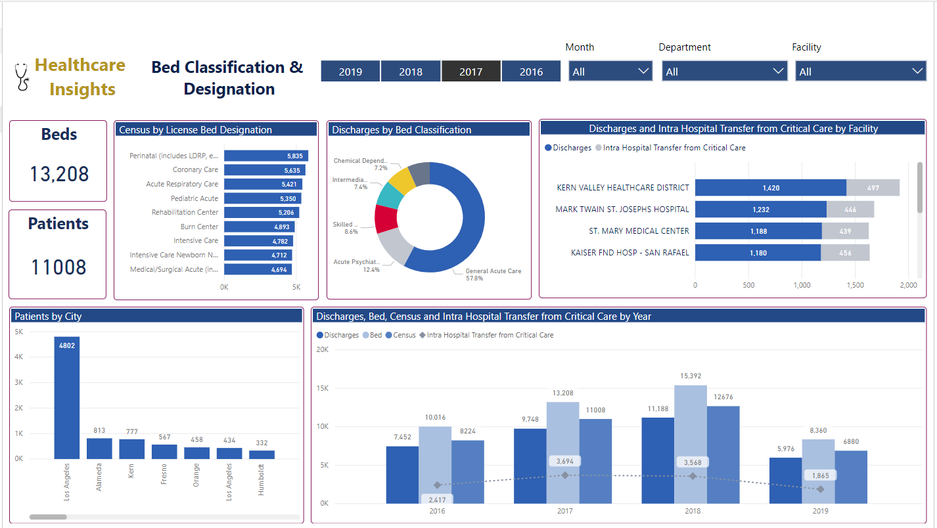
Power BI Healthcare Dashboard
Healthcare Resource Management
In healthcare, efficiently managing resources like beds, patient flow, and critical care transfers is crucial for maintaining quality patient care. KPIs such as bed occupancy, patient admissions, and discharge rates help healthcare facilities optimize operations and allocate resources effectively. Real-time insights into these metrics allow hospitals to improve patient outcomes and manage capacity more efficiently.
Power BI helps healthcare facilities track and optimize resources in real-time, improving patient care and operational efficiency.
www.scalenowtech.com

Slide 13
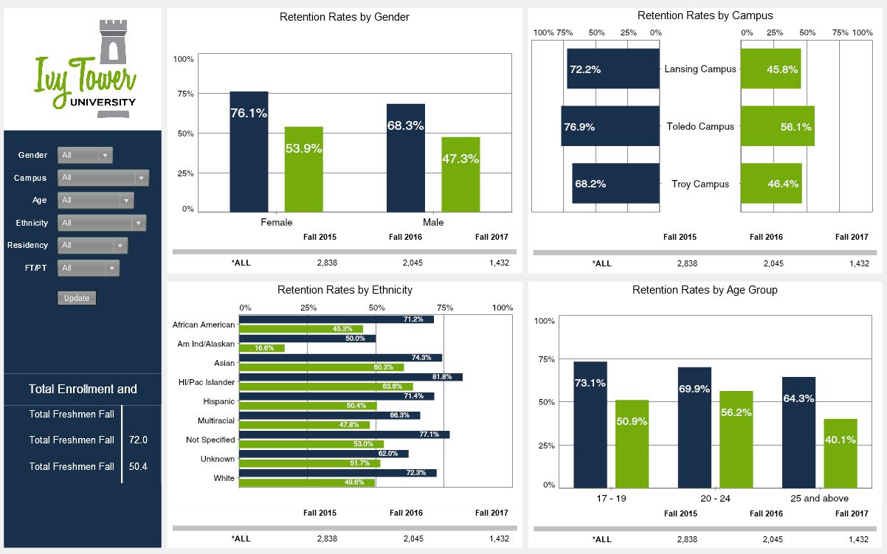
Power BI Education Dashboard
Education Performance Tracking
In education, monitoring student retention rates, enrollment numbers, and demographic breakdowns is essential for improving academic success. KPIs such as retention by gender, campus, and ethnicity help institutions identify areas for improvement and ensure student support. These metrics allow universities to tailor programs and resources to increase retention and graduation rates.
Power BI helps educational institutions track retention rates and enrollment trends, enabling data-driven strategies for student success.
www.scalenowtech.com

Slide 14


SWOT Analysis of Power BI
Seamless Microsoft Integration
Steep Learning Curve & Cost
Power BI integrates smoothly with the Microsoft ecosystem.
Enhances user experience through robust data analysis and visualization tools.
Complexity may challenge beginners.
Requires time and effort to master
Licensing and usage fees may deter smaller businesses..
S
W
Growing BI market, & AI advancements
O
T
Strong Competition
Competing tools offer similar features.
Affordability and accessibility of alternatives may lure customers away.
Expanding demand in the Business Intelligence market.
Offers significant growth potential.
Leveraging AI could boost Power BI's analytical capabilities.
Enhances market competitiveness.

Slide 15
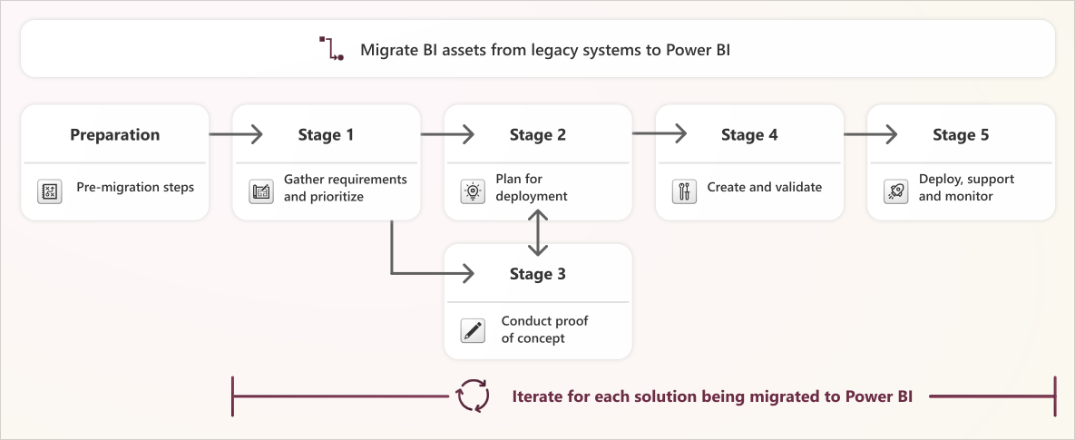
Migration Plan
www.scalenowtech.com

Slide 16

Seamless Integration of Advanced ML Capabilities
Add built-in machine learning features that provide predictive and prescriptive insights directly within Power BI, unlocking the full potential of data analysis.
Deep, Detailed Insights
Use machine learning to uncover hidden data patterns and provide contextual, actionable insights, offering a level of analysis that goes beyond traditional reporting tools.
Simplified Complexity and Resource Efficiency
Reduce the complexity of advanced analytics by automating processes with machine learning. Empower small to medium-sized businesses to leverage sophisticated analytics without the need for extensive technical expertise.
Possible Enhancements Using Machine Learning
www.scalenowtech.com

Slide 17


Our Solution
Ease of Use
Intuitive interface with drag-and-drop features.
Simplifies complex analytics for non-technical users on platforms like Power BI.
01
Seamless Integrations
AI-Driven Insights
Seamless integration with Power BI, Microsoft, and Google Workspace.
Enhances efficiency and collaboration across platforms with plug-and-play modules.
05
02
Leverages advanced AI for predictive analytics.
Supports natural language querying for automated insights within platforms like Power BI.
Customizability
Affordability & Accessibility
Tailored dashboards and KPI metrics for specific business needs.
Ensures relevance and usability with personalized insights for every user.
04
03
Competitive pricing models accessible to businesses of all sizes.
High-value, advanced ML capabilities at an affordable cost, ensuring wide reach.

Slide 18


Our Expertise
Consulting
Integration
Our experts guide your organization through the ML integration journey:
Create a custom roadmap for data insights.
Evaluate existing workflows.
Implement advanced AI-powered analytics tools.
With ScaleNow integration services, decision-makers receive real-time insights:
Connect with multiple data sources.
Integrate AI-based anomaly detection.
Enhance data exploration and KPI tracking.
www.scalenowtech.com

Slide 19
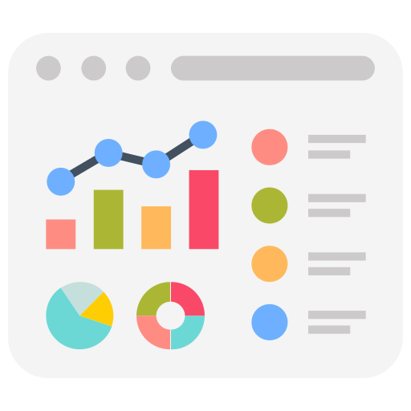

Our Expertise
Dashboard Development
AI-Powered Insights
Create interactive, customized dashboards to visualize critical data:
Generate real-time visualizations from multiple data sets.
Ensure insights are visible across all devices.
Tailor dashboards to match your KPIs.
Leverage advanced AI models to predict trends and anomalies:
Automated forecasting.
Predictive analysis tailored to your industry.
Customized insights for strategic decision-making.
www.scalenowtech.com

Slide 20

Our Expertise
Custom Solutions
Tailored services for your industry’s specific needs:
Advanced ML modules for real-time monitoring.
Custom KPI tracking for Finance, Retail, Manufacturing, etc.
Continuous improvement with ML feedback loops.
www.scalenowtech.com

Slide 21
Scope of Work
Gap Analysis: Identify discrepancies between current operations and the desired outcomes.
Business Process Blueprint: Create a detailed plan outlining every aspect of the business processes.
Solution Architecture: Design a tailored solution architecture to meet specific business needs.
Custom ML Implementation: Integrate machine learning models into existing data dashboards for enhanced predictive analytics and actionable insights.
www.scalenowtech.com

Slide 22
Sol Dev & Validation
Requirement Validation: Align the proposed solution with client needs to ensure all requirements are met.
Project Kick-off: Begin development after receiving client approval and finalizing the project plan.
Iterative Development & Testing: Implement the solution in stages while continuously testing to ensure functionality and accuracy.
Client Review & Feedback: Present each phase to the client for review, allowing for adjustments and refinements.
Final Delivery & Training: Upon approval, deliver the final solution, provide necessary training, and ensure a smooth handover.
www.scalenowtech.com

Slide 23
Data Security & Access Control
Feature | Description
Seamless Integration | Works within existing Microsoft and Google Workspace security protocols.
AI-Driven Security | Leverages machine learning for proactive threat detection.
Granular Role-Based Access | Provides customized access controls tailored to user roles.
Compliance & Encryption | Ensures data integrity and compliance with industry standards like GDPR.
Continuous Monitoring | Adapts security measures based on real-time analytics and emerging threats.
www.scalenowtech.com

Slide 24
Our Pricing
Service Tier | Licensing Fees | Customization Fees | Included Features & Support
Essential Package | ₹42,000/month | ₹84,000/project | Core features, basic support, limited customization
Pro Package | ₹1,680/user/month (Developer Power BI) | ₹1,50,000/project | Advanced features, priority support, full customization
Enterprise Solution | Custom Power BI Licensing (based on users) | ₹3,60,000/project | Full features, dedicated support, advanced customization
www.scalenowtech.com

Slide 25



Let’s Talk!
+91 9830607796
suvankar.malakar@scalenowtech.com
https://www.linkedin.com/company/scalenow-technosolutions-private-limited/posts/?feedView=all
www.scalenowtech.com

Slide 26
Other Slides

Slide 27
Architecture
Overview:
Data Ingestion: Multi-source integration.
Preprocessing: Automated data preparation.
ML Models: AutoML, custom models.
Insights: Real-time, predictive analytics.
Integration: Seamless, plug-and-play.
User Interaction: NLP, dashboards.
Security: RBAC, compliance.
Advantage: Enhanced ML capabilities within existing tools.
www.scalenowtech.com

Slide 28

Excel: The Essential Tool for Business Analysis
01
02
03
04
05
Excel as a Data Analysis Tool
Financial Reporting Importance
Handling Large Datasets
Collaboration Challenges
Limited Advanced Analytics
Potent for data analysis
Efficient manipulation
Visualize data
Struggles with large data
Performance issues
Analysis hindrance
Cumbersome collaboration
Multi-user difficulties
Simultaneous work challenges
Vital for financial reporting
Informed decisions
Accurate data presentation
Lacks advanced capabilities
Unsuitable for complex tasks
www.scalenowtech.com

Slide 29
Industry & KPI Customization
Tailored KPIs: Customize key performance indicators (KPIs) based on specific industry needs (e.g., Finance, Retail, Healthcare, Manufacturing).
Industry-Specific Dashboards: Pre-built templates and dashboards designed for each sector, ensuring relevant metrics and visualizations.
Real-Time Data Integration: Connects with multiple data sources to ensure up-to-date, accurate data is reflected in customized KPIs.
Advanced ML Insights: Uses ML models to track KPIs and predict future trends based on historical data, tailored for each industry.
Actionable Alerts: Anomaly detection and predictive alerts that are fine-tuned for industry-specific KPIs.

Slide 30




Business Analysis Tools: The Available Options
01
02
03
Power BI
Tableau
Metabase
Robust data visualization & interactive dashboards
Seamless Microsoft integration
Ideal for large enterprises needing real-time analytics
Advanced visualization with a user-friendly interface
Supports diverse data sources
Best for deep data exploration & complex visuals
Cost-effective, open-source BI tool
SQL-friendly, easy setup
Suitable for small to medium businesses
04
05
06
Notion
Qlik Sense
Looker
Combines note-taking, task management, & light analytics
Versatile for lightweight analysis
Ideal for startups or small teams
Self-service analytics with an associative model
Integrates with multiple data sources
Great for flexible, large-scale data exploration
Powerful data modeling & real-time dashboards
Integrates with Google Cloud
Perfect for cloud-reliant businesses

Slide 31
Power BI Dashboard

Slide 32

Services
Seamless ML Integration
Power BI: While Power BI requires external integrations for advanced ML, ScaleNow offers built-in ML capabilities directly within the platform, making it easier for users to apply machine learning models without leaving their primary analytics environment.
Advantage: Users can apply pre-trained models directly on their data with minimal setup, saving time and reducing the complexity typically associated with ML workflows.
www.scalenowtech.com

Slide 33

Services
Natural Language Processing (NLP)
Power BI: Power BI offers basic natural language querying through its "Q&A" feature, allowing users to ask simple questions about their data. However, ScaleNow elevates this capability with advanced NLP that not only processes queries but also delivers contextual insights, trends, and personalized recommendations.
Advantage: Users can engage in complex, conversational interactions with their data, asking detailed questions and receiving actionable insights and recommendations that are intuitive and easy to interpret.
www.scalenowtech.com

Slide 34
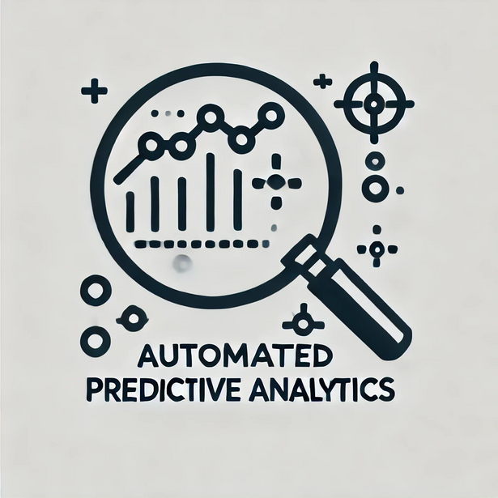
Services
Automated Predictive Analytics
Power BI: While Power BI offers some predictive features, it requires manual setup and expertise. ScaleNow streamlines this with fully automated predictive analytics, allowing businesses to forecast trends and risks effortlessly.
Advantage: Predict market shifts, customer behaviors, and operational inefficiencies with minimal effort, empowering businesses to stay ahead.
www.scalenowtech.com

Slide 35

Services
Advanced Anomaly Detection
Power BI: Power BI includes basic anomaly detection, but its capabilities are limited without manual setup. ScaleNow enhances this by providing advanced, automated anomaly detection, instantly flagging outliers and potential issues.
Advantage: Ensure continuous monitoring of critical metrics with real-time alerts for anomalies, allowing businesses to act quickly and mitigate risks.
www.scalenowtech.com

Slide 36

Services
Real-Time Data Insights
All Platforms: While existing platforms offer some real-time capabilities, ScaleNow’s ML models are designed to process and analyze streaming data in real-time, providing immediate insights and enabling quicker decision-making.
Advantage: Businesses can react faster to changing conditions, making informed decisions that keep them ahead of the competition.
www.scalenowtech.com

